Slide 1
INTRODUCTION TO VECTORISATION AND SEMANTIC SEARCH Transforming Data into Meaningful Insights
Presented by John Staveley MVP

Slide 2

Welcome
Hello, I’m John Staveley
25 years as software engineer
Community lead at Leeds Data Science, Leeds Sharp and the AIoTHub

Slide 3
LEXICAL VS Similarity search
I want to find animals in some search text e.g. “The Quick brown fox jumped over the lazy dog”
Lexical Search: Text Contains ‘%Dog%’ OR Text Contains ‘%Cat%’ OR Text Contains ‘%Elephant%’ etc etc
Semantic Search: Text Contains ‘Animal’

Slide 4

Why Vectorisation matters
Better search results
Smarter recommendations (e.g. shopping)
Semantic understanding in AI

Slide 5
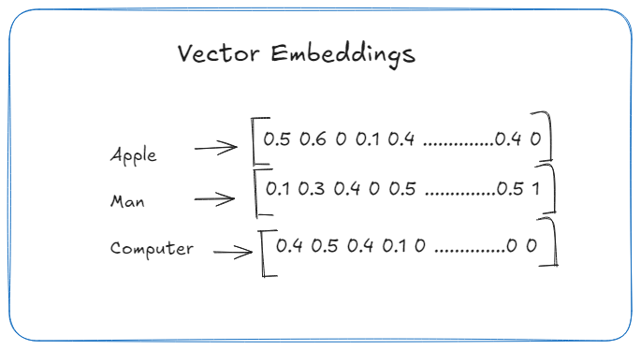
VECTORISATION BASICS
What is a vector?
“Text” → vector embedding (small table of numbers)
“Image/Sound/Video” → feature vector

Slide 6
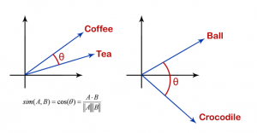
SIMILARITY METRICS

Slide 7
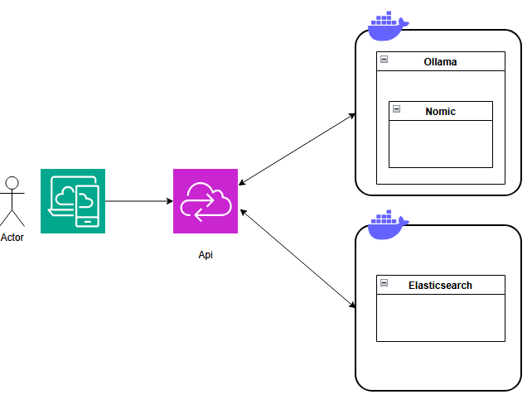
ARCHitecture

Slide 8
OLLAMA
Is a model container:
DeepSeek - open reasoning models with performance approaching that of leading models
Llama 3.2 – State of the art model
Llava – Image to text model
Phi – Coding help and debugging
Nomic-embed-text – High performance embedding model
Lots of others
Azure foundry for cloud based solution

Slide 9
ELASTICSEARCH
Using it to store vectors. It is
Json format, schemaless
Open source
Full-Text search
Rest api
Distributed and scalable
Spatial and vector search
Probably worth mentioning some of the alternatives here

Slide 10

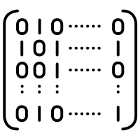



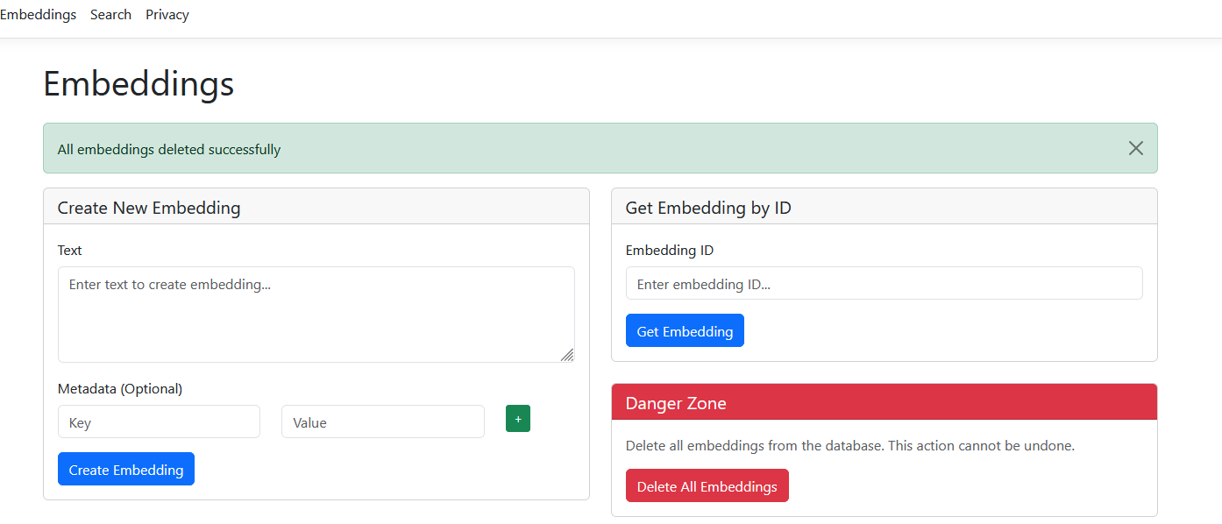
VECTOR Similarity Search Process
→ → → →
Query → Vectorisation → Index → Search → Results
Demo time!

Slide 11



INDEXING methods
3-column layout:
Brute Force →
ANN →
Indexing methods
Flat index → High accuracy, computationally expensive
HNSW → Large datasets, performance required
IVF → large datasets where speed is crucial
PQ → faster lookup, accuracy loss. Can be combined with other methods

Slide 12
Real-World Applications
E-commerce product grid. | Image search results.
Medical scan comparison. | Face recognition overlay.

Slide 13



CHALLENGES
→ “High-dimensional cost”
→ “Bias in embeddings”
→ “Dynamic datasets”

Slide 14
Future Trends
Futuristic gradient background.
cons for:
Multimodal AI (text+image+audio combined)
Mobile device with lock (on-device search)
AI brain with gears (self-learning indexes).

Slide 15
Summary
Data -> Vectors
Vectors -> Similarity Search
AI -> Smarter Results
Slides and code: https://github.com/johnstaveley/Vectorisation
Any questions?

